Slide 1
Android Layouts

Slide 2
Layout Basics
What Is A Layout?
A type of resource that defines what is drawn on the screen. Layout resources are stored as XML files in the /res/layout resource directory for the application. A layout resource is simply a template for a user interface screen, or portion of a screen, and contain.
A type of View class whose primary purpose is to organize other controls. These layout classes (LinearLayout, RelativeLayout, TableLayout, etc. ) are used to display child controls, such as text controls or buttons or images on the screen.

Slide 3
Layout Basics
A type of View class whose primary purpose is to organize other controls. These layout classes (LinearLayout, RelativeLayout, TableLayout, etc. ) are used to display child controls, such as text controls or buttons or images on the screen.
Declare UI elements in XML.:-
  Android provides a straightforward XML vocabulary that corresponds to the View classes and subclasses, such as those for widgets and layouts.
Instantiate layout elements at runtime:-
  Your application can create View and ViewGroup objects (and manipulate their properties) programmatically.

Slide 4
Linear Layout
Designed to display child View controls in a single row or column. This is a very handy layout method for creating forms.
A layout that organizes its children into a single horizontal or vertical row.
In a linear layout, like the name suggests, all the elements are displayed in a linear fashion(below is an example of the linear layouts), either Horizontally or Vertically
All children of a LinearLayout are stacked one after the other, so a vertical list will only have one child per row, no matter how wide they are, and a horizontal list will only be one row high (the height of the tallest child,

Slide 5
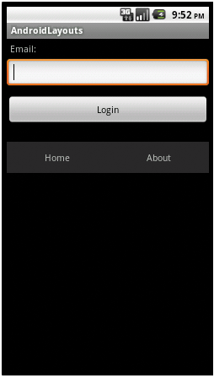

Linear Layout
A LinearLayout respects margins between children and the gravity (right, center, or left alignment) of each child.

Slide 6
Relative Layout
Relative Layout is a view group that displays child views in relative positions. The position of each view can be specified as relative to sibling elements (such as to the left-of or below another view) or in positions relative to the parent Relative Layout area (such as aligned to the bottom, left of center).
In a relative layout every element arranges itself relative to other elements or a parent element.
Designed to display child View controls in relation to each other. For instance, you can set a control to be positioned “above” or “below” or “to the left of” or “to the right of” another control, referred to by its unique identifier. You can also align child View controls relative to the parent edges.

Slide 7
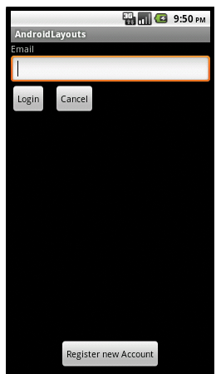

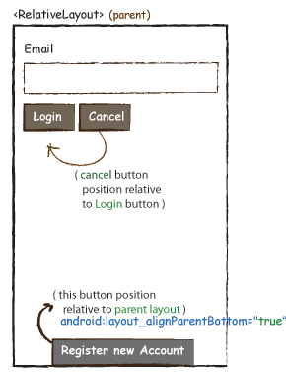
Relative Layout
A Relative Layout is a very powerful utility for designing a user interface because it can eliminate nested view groups and keep your layout hierarchy flat, which improves performance.
If you find yourself using several nested LinearLayout groups, you may be able to replace them with a single RelativeLayout.

Slide 8
Table Layout
Table layouts in Android works in the same way HTML table layouts work. You can divide your layouts into rows and columns. Its very easy to understand.
Like a normal table tag, it enables you to group views by rows and columns. Every views you place inside a row forms a cell. The cells' width is determined by the largest cell by that column.
Designed to organize child View controls into rows and columns. Individual View controls are added within each row of the table using a TableRow layout View (which is basically a horizontally oriented LinearLayout) for each row of the table.

Slide 9
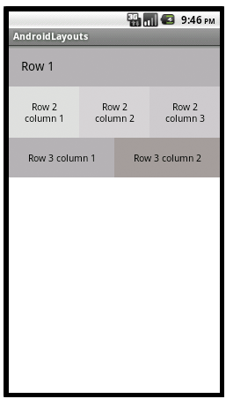
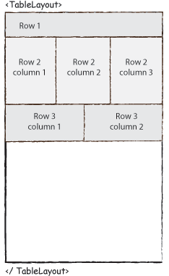
Table Layout

Slide 10
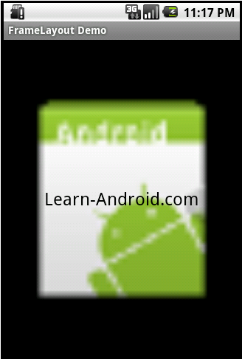
Frame layout
Frame layouts are one of the simplest and most efficient types of layouts used by Android developers to organize views.
They are used less often than some other layouts, simply because they are generally used to display only one view, or views which overlap.
The frame layout is often used as a container layout, as it generally only has a single child view (often another layout, used to organize more than one view).

Slide 11
SEEK BAR
A SeekBar is an extension of ProgressBar that adds a draggable thumb. The user can touch the thumb and drag left or right to set the current progress level or use the arrow keys. Placing focusable widgets to the left or right of a SeekBar is discouraged.
Clients of the SeekBar can attach a SeekBar.OnSeekBarChangeListener to be notified of the user's actions.

Slide 12
SEEK BAR
OnSeekBarChangeListener
A callback that notifies clients when the progress level has been changed. This includes changes that were initiated by the user through a touch gesture or arrow key/trackball as well as changes that were initiated programmatically.
Public Methods :
  abstract void onProgressChanged(SeekBar seekBar, int progress, boolean fromUser) Notification that the progress level has changed.
  abstract void onStartTrackingTouch(SeekBar seekBar) Notification that the user has started a touch gesture.
  abstract void onStopTrackingTouch(SeekBar seekBar) Notification that the user has finished a touch gesture.

Slide 13
SEEK BAR
To add Listener to seek bar use following method:
public void setOnSeekBarChangeListener (SeekBar.OnSeekBarChangeListener )
Sets a listener to receive notifications of changes to the SeekBar's progress level. Also provides notifications of when the user starts and stops a touch gesture within the SeekBar.

Slide 14
SEEK BAR
Example Code:-
// In OnCreate ()
SeekBar sb;
sb=(SeekBar)findViewById(R.id.seekBar1);
sb.setOnSeekBarChangeListener(this);
public void onProgressChanged(SeekBar seekBar, int progress, boolean fromTouch)
{
t1.setText(""+progress);
}

Slide 15
Android Intents

Slide 16
Introduction
Intents are asynchronous messages which allow Android components to request functionality from other components of the Android system.
An intent is an abstract description of an operation to be performed. It can be used with startActivity to launch an Activity,
Intents can be used to signal to the Android system that a certain event has occurred. Other components in Android can register to this event via an intent filter.
An Intent provides a facility for performing late runtime binding between the code in different applications.
Its most significant use is in the launching of activities, where it can be thought of as the glue between activities.

Slide 17
Intent Class
Intents are send to the Android system via a method call, e.g. via the startActivity() method you can start activities
Intent Class:-
Intents are instances of the android.content.Intent class.
Constructors:-
public Intent ():- Create an empty intent.
public Intent (Intent o) :- Copy constructor..
public Intent (Context packageContext, Class<?> cls)
  Create an intent for a specific component. This provides a convenient way to create an intent that is intended to execute a hard-coded class name, rather than relying on the system to find an appropriate class for you;

Slide 18
Intent Class
Parameters
packageContext A Context of the application package implementing this class.
cls The component class that is to be used for the intent.
For example an activity can send an intent to the Android system which starts another activity via the following code.
Intent i = new Intent(this, ActivityTwo.class);
startActivity(i);

Slide 19
Explicit Intents
Explicit intents explicitly defines the component which should be called by the Android system, by using the Java class as identifier.
which provides the exact class to be run.
Often these will not include any other information, simply being a way for an application to launch various internal activities it has as the user interacts with the application
The following shows how to create an explicit intents and send it to the Android system. If that class represents an activity Intent the Android system start it.
Intent i = new Intent(this, ActivityTwo.class); i.putExtra("Value1", "This value one for ActivityTwo "); i.putExtra("Value2", "This value two ActivityTwo");

Slide 20
Implicit Intents
Implicit intents specify the action which should be performed and optionally data which provides data for the action.
Implicit Intents have not specified a component; instead, they must include enough information for the system to determine which of the available components is best to run for that intent.
Example:
Intent intent = new Intent(Intent.ACTION_SEND);

Slide 21
Intent Example
Calling one activity from other :-
public void onclick(View v){
switch(v.getId()){
case R.id.button1:
Intent i=new Intent(this,SubActivity.class);
startActivity(i);
finish();

Slide 22
Passing Data across the Intents
When one activity calls the other activity and wants to pass the data the calling activity has to add data inside intent using following method of Intent class.
putExtra(key,value);
Example:-
  String un=t1.getText().toString();
  Intent i=new Intent(this,SubActivity.class);
  i.putExtra("key", un);
  startActivity(i);

Slide 23
Passing Data across the Intents
The second activity has to read the passed data by getting current intent object using getIntent() method.
Then read the data using following methos of Intent class:-
getExtras().getString(key);
Example:-
  Intent si=getIntent();
  String s=si.getExtras().getString("key");

